Slide 1
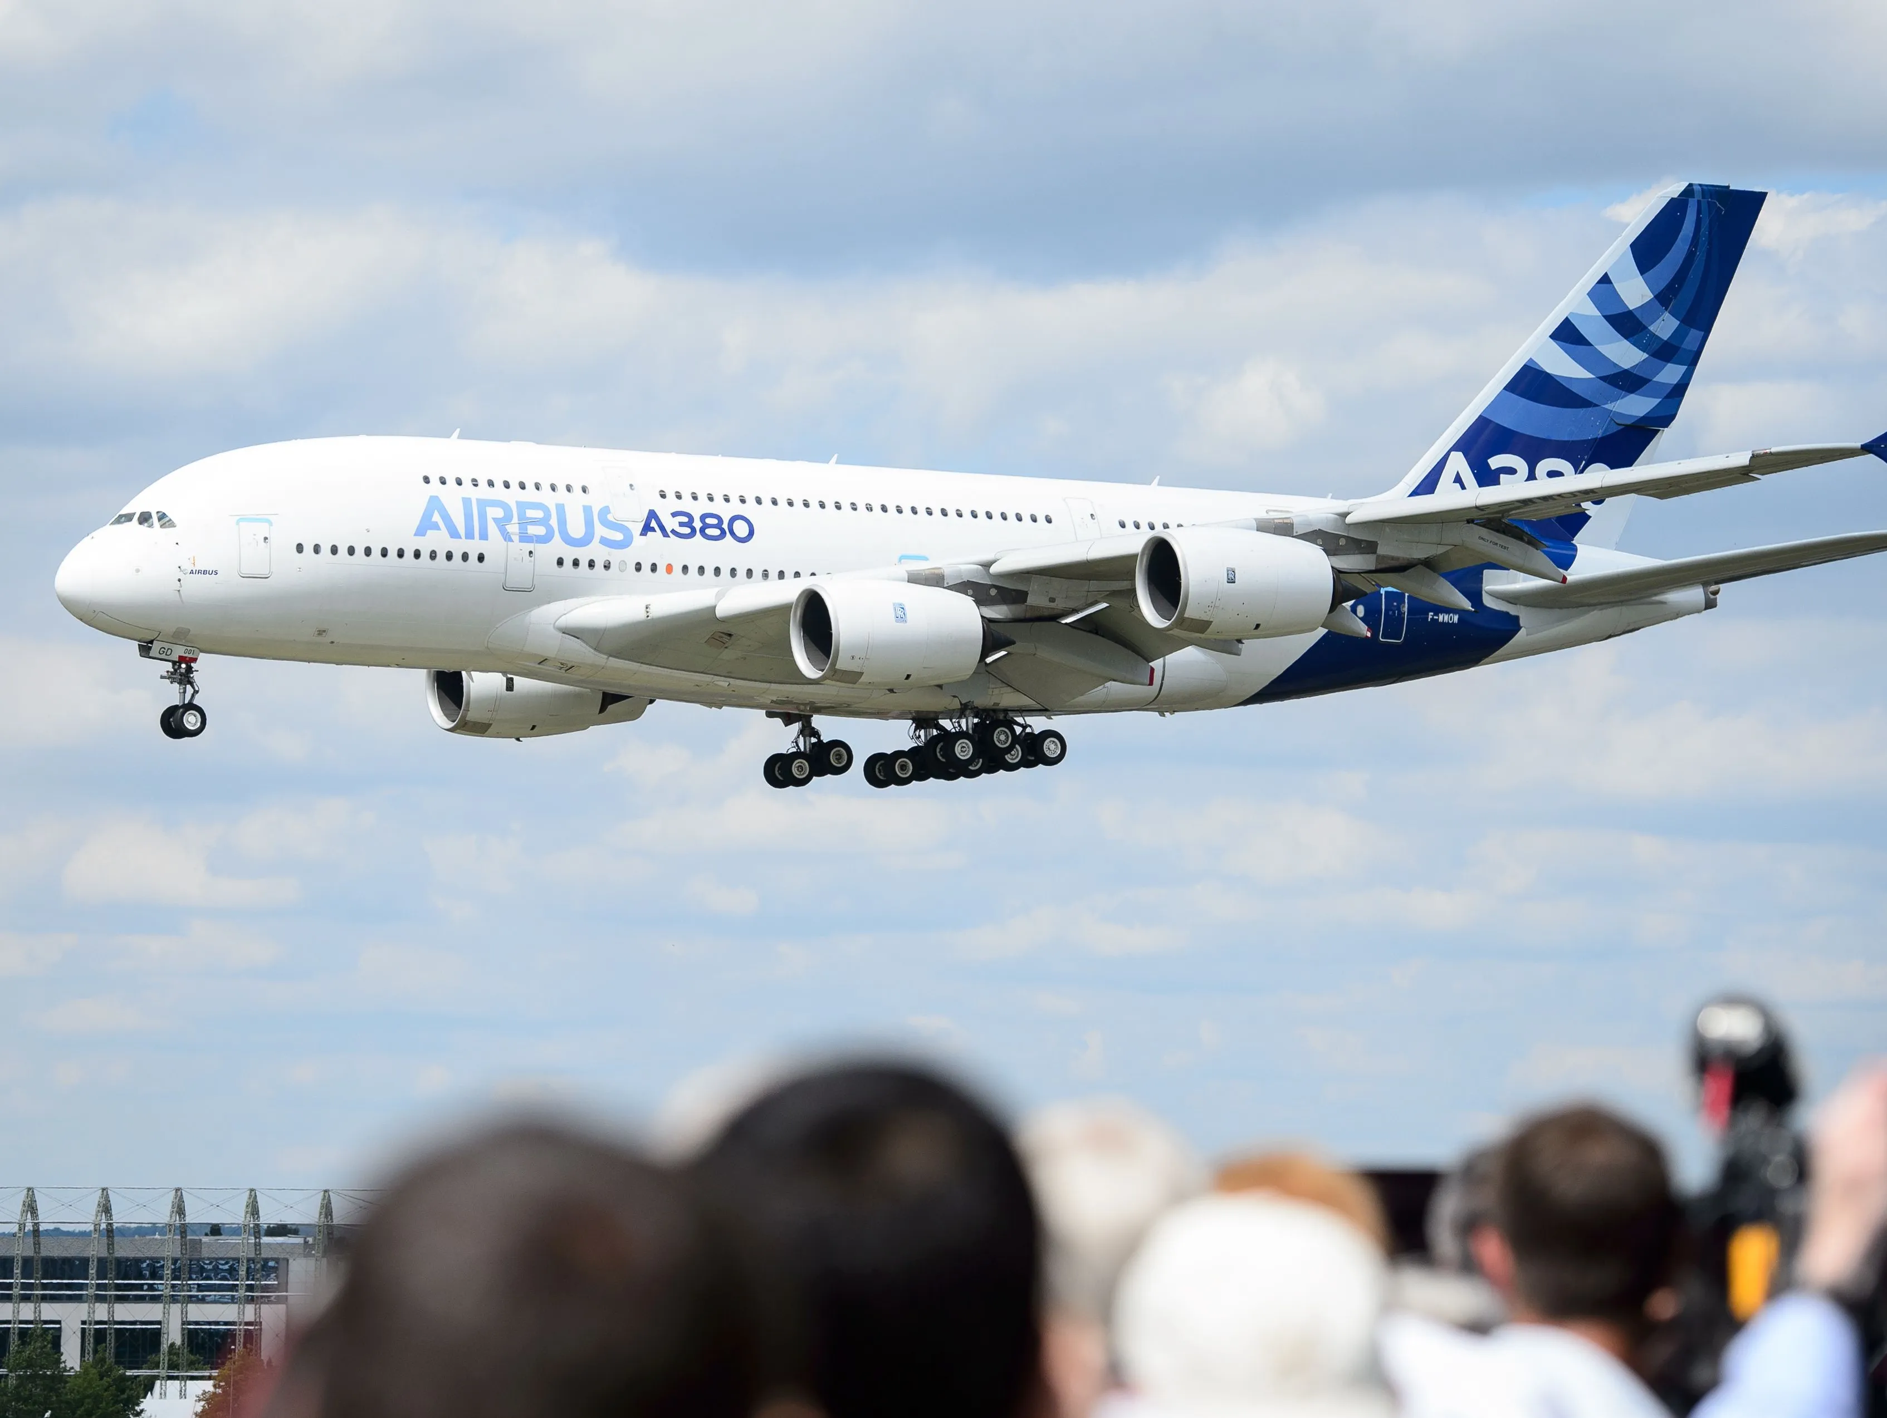
THE RISE AND DEMISE OF AIRBUS A380
Timing of Entry
Defining the Organization’s Strategic Direction

Slide 2
The late 1990s.
The rise of the hub-and-spoke model
Allowed airlines to connect flights with other cities across the globe.
Supported airport stopovers and airport shopping, creating a symbiotic relationship between airlines and airports.
What supported this ?
Very large aircrafts
Why ?
More seats per plane
More fuel efficient
Less cost per seat

Slide 3
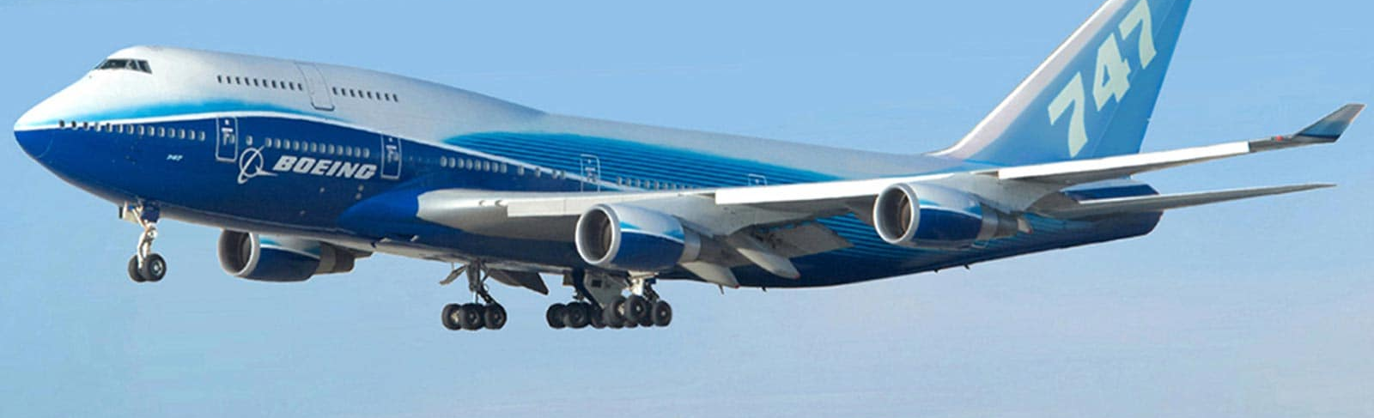

Existing Monopoly
They sold over 950 units between 1965 to 2000.
Boeing B747
Wide body and spacious interior
Ideal for both passengers and cargo operators

Slide 4







Airbus wanted to play
Formation of Airbus Consortium
Allowed airlines to connect flights with other cities across the globe.
Supported airport stopovers and airport shopping, creating a symbiotic relationship between airlines and airports.
Early Challenges and Successes
First aircraft, The A300, wide body aircraft – Poor market response
1981, The A320 narrow body aircraft – Huge success.
Over 400 orders before its first flight.
Shift in Market Dynamics
Long haul flights
Hub & Spoke model
Monopoly
Boeing's Dominance

Slide 5
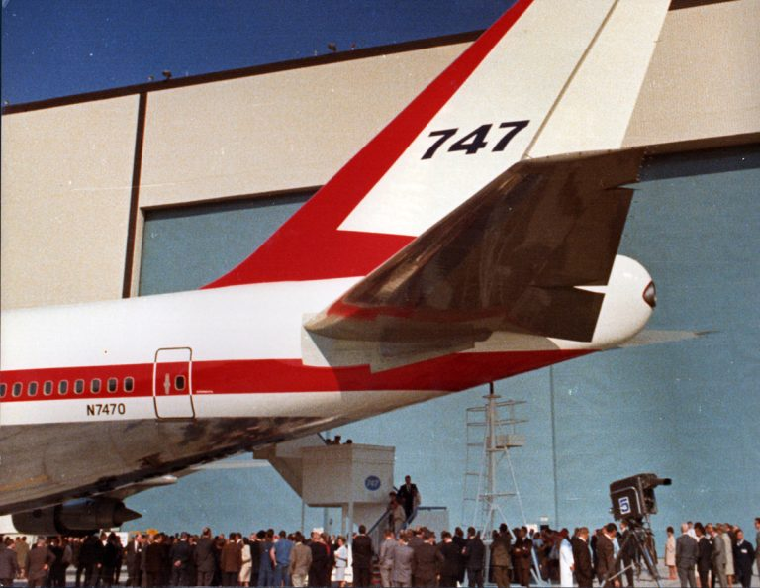
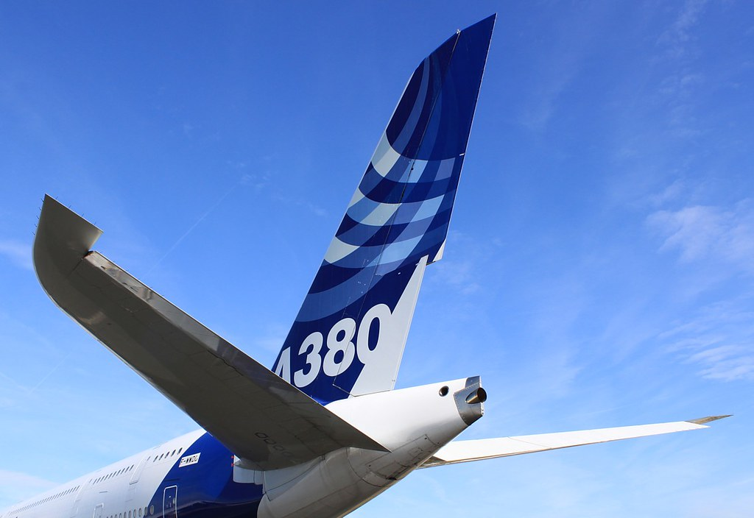
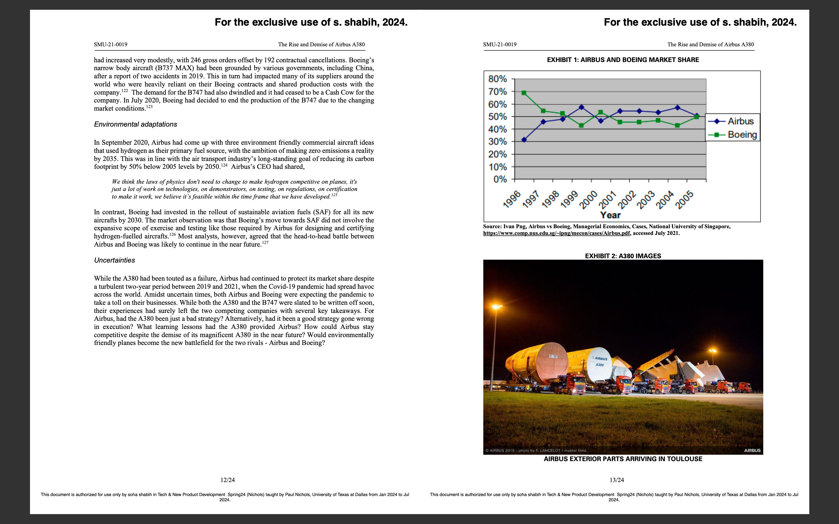
Emerging Duopoly
In 1997 demand was forecasted to drive the airlines market to $1 trillion over the next two decades.
The two giants were on a race
B747 was driving Boeing’s game.
Operating profit of US $40 million per plane
Selling price was US $150 million per plane
an average of 27 planes per year (1989 to 1999)
How did they do this ?
Reliance on extensive supplier networks globally for manufacturing components.
Boeing – Everett & Renton at Washington
Airbus – 5 different locations in Europe. Final assembly at Toulouse, France, or Northern Germany.

Slide 6
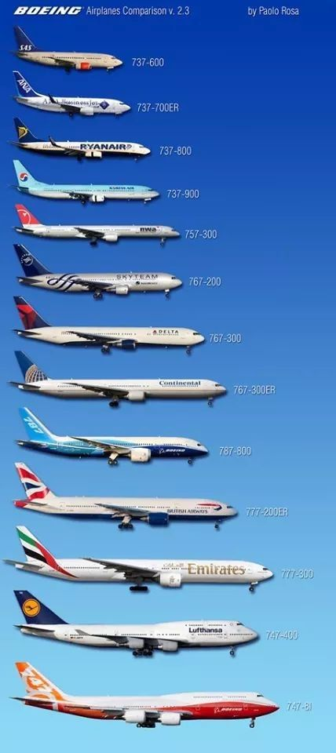
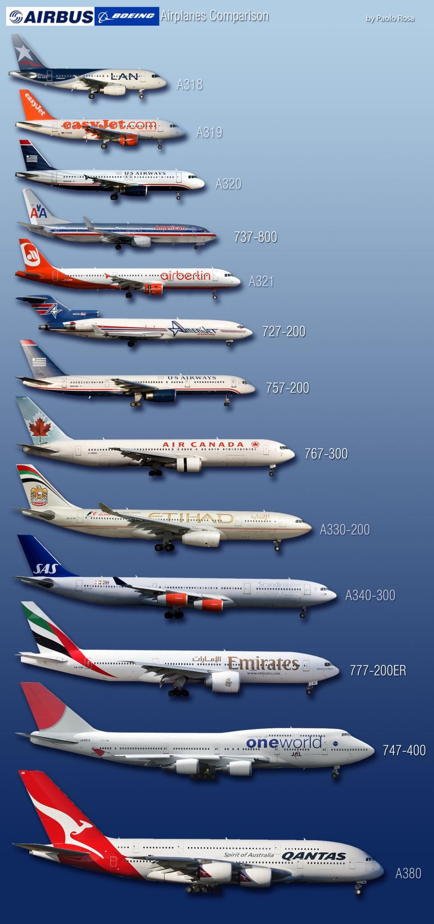
Airlines Reaction
By 1998, the airline industry had consolidated into two distinct market segments:
Hub-and-spoke market: Dominated by established and powerful carriers.
Peripheral markets: Serviced by point-to-point carriers, exemplified by Southwest Airlines.
Preference to similarity
Why ? Because crew qualification played a major factor.
This influenced Boeing & Airbus to build commonality in all their models to promote sales & decrease operating costs.

Slide 7




Ending the 747 Monopoly
"If Airbus Industries was to become a real global player, the 747 monopoly would have to end. Airbus was making efforts at this time to get 30 percent of the market, and we thought that this just would not be possible in the long term if we did not get a complete set of aircraft in our program"
CUSTOMERS
-Jean Roeder, Senior executive at Airbus​

Slide 8
A380 Launch Timeline
2005
2001
1998
First prototype released in Toulouse
1994
Airbus A3XX design finalized and named as A380
1990
Airbus clinched 56% of market for new aircrafts with 556 new orders
1988
Idea of superjumbo A3XX project
Project announced to challenge Boeing dominance
Study of Airbus started
Notes:
Jean Roeder, the head of the small group of designers, surprised the Airbus leadership team with a model of the A380 during a lunch meeting.
Airbus embarked on a secret project called the Ultra-High-Capacity-Airliner (UHCA), even keeping it hidden from their CEO.
CEO- BERNARD
The CEO was taken aback by its size but gave the green light for further development.

Slide 9

Behind the scene
Number 380:
A departure from the Airbus sequence (A300 to A340).
Symbolic Alignment:
The digit 8 mirrors the double-deck interior cross-section of the model.
Lucky Number:
In Asian countries, especially China (a promising growth market at the time), 8 holds significance.
Cost Efficiency Goal:
The target was a 15–20% reduction in operating costs compared to the existing Boeing B747–400.

Slide 10
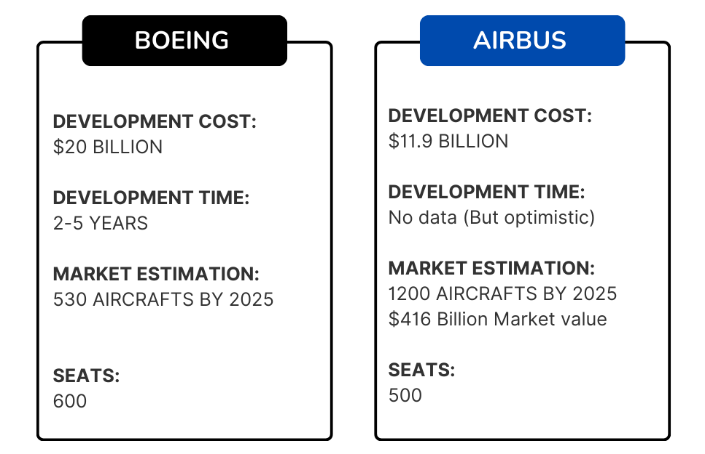
Barriers to entry
Unsuccessful talks between airbus and Boeing for a joint venture in the super-jumbo market.
Notes:
Varnika
Background
Airbus and Boeing once explored the possibility of jointly creating a “super-jumbo” aircraft.
However, their collaboration talks eventually fizzled out due to differing perspectives.

Slide 11






Key Factors Driving Decision
Operating Costs
Hub-and-Spoke Networks
Importance of fixed operation costs per seat.
Goal: Maximize revenue through efficient operation.
Significance in airline operations.
Role of high-capacity aircraft in revenue maximization.
Airport Slot Availability
Passenger Preferences
Impact of limited slots on revenue generation.
Advantage of using larger aircraft (A380) to accommodate more passengers.
Benefits of large aircraft:
Increased comfort standards.
Lower fuel consumption per passenger.
Lower costs per passenger mile.
Economic Feasibility
Preference for lower airfares.
Role of hub connections in achieving cost-effective travel.
Notes:
1. Operating Costs
Each seat on a plane contributes to the total flight cost.
Revenue per seat and overall revenue play a crucial role in decision-making.
The A380’s large capacity allows for better cost distribution, maximizing revenue.
2. Hub-and-Spoke Network Strategy
Higher revenues: Larger aircraft (like the A380) can achieve higher load factors.
Cost savings: Fixed ground facilities and personnel remain the same.
Example: A380 enables nearly 10 million more passengers at London Heathrow without increasing flights.
3. Airport Slot Availability
Limited slots at airports pose challenges.
Solution: Use larger airplanes (like the A380) to maximize revenue capacity.
4. Economic Feasibility
Airbus foresaw a market for 1,200 super-jumbo passenger aircrafts by 2025 (approx. US$416 billion value).
A380’s economic viability hinged on its capacity and operational efficiency.
5. Passenger Preferences
Survey findings (2004):
33% of respondents chose flights based on airfare.
Only 11% prioritized non-stop service.
Connecting flights via hubs were common, offering lower prices.
Conclusion
The A380 revolutionized air travel:
Efficient use of resources.
Enhanced passenger experience.
A testament to visionary thinking.

Slide 12
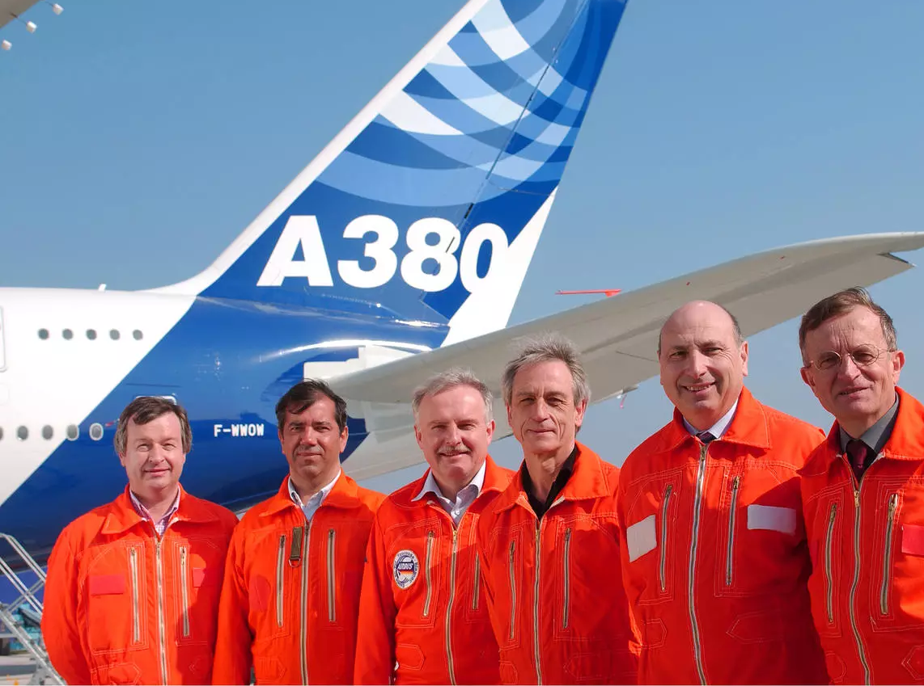
Rise of A380
The Airbus A380, introduced in 2005, was a revolutionary aircraft in the aviation industry, known for its size and capacity.
It was the world's largest passenger airliner, designed to accommodate the growing demand for air travel, particularly in high-density routes.
Notes:
Sahana

Slide 13
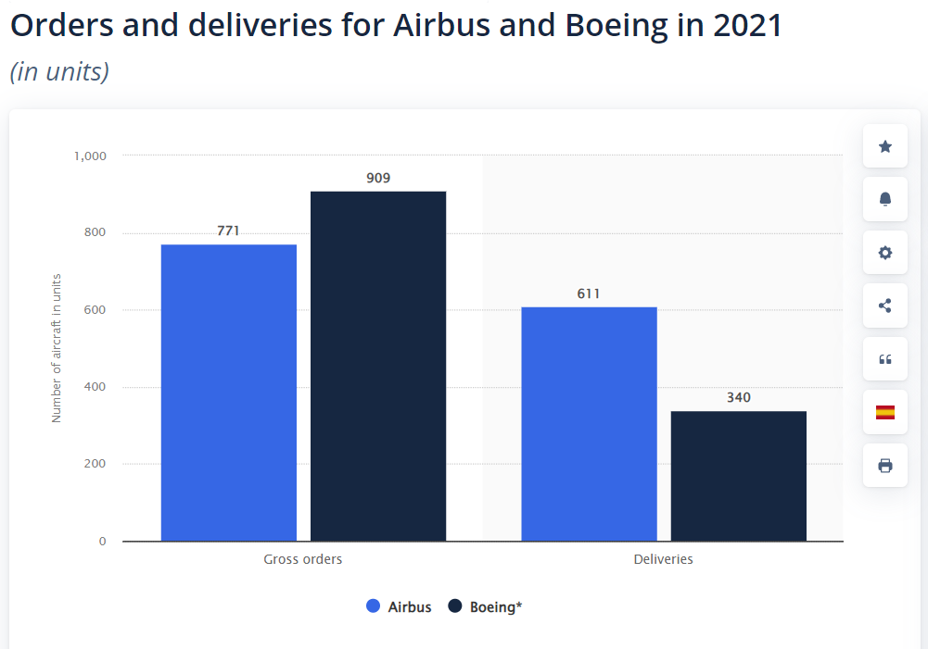
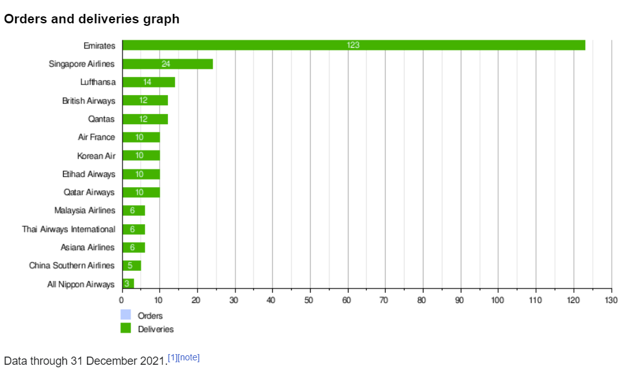
Early Orders and Confidence:
2001 - Airbus secured 50 firm orders from six major airlines, including Air France, British Airways, Emirates Airlines, Qantas Airways, Singapore Airlines (SIA), and Virgin Atlantic.
Demonstrated strong confidence in the A380 project, with the same airlines also taking options to buy another 42 of the new jets.
Notes:
Sahana

Slide 14
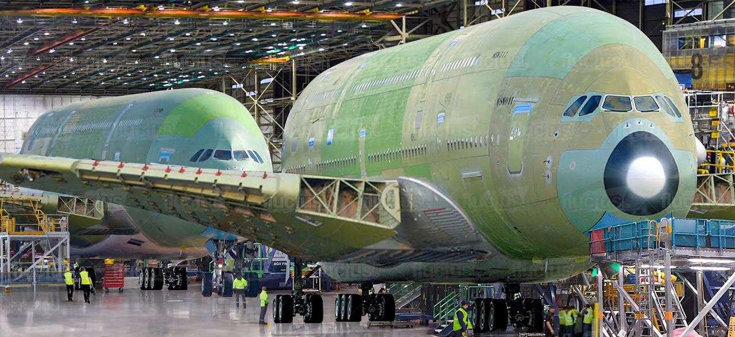
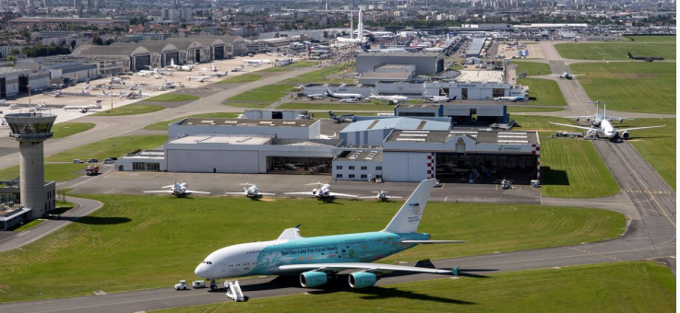
Production Timeline
2002
Manufacturing began - wing-box component
2003
Subassembly
2004
Final assembly
2005
Prototype unveiled
April 27th – First flight with SIA took off

Slide 15
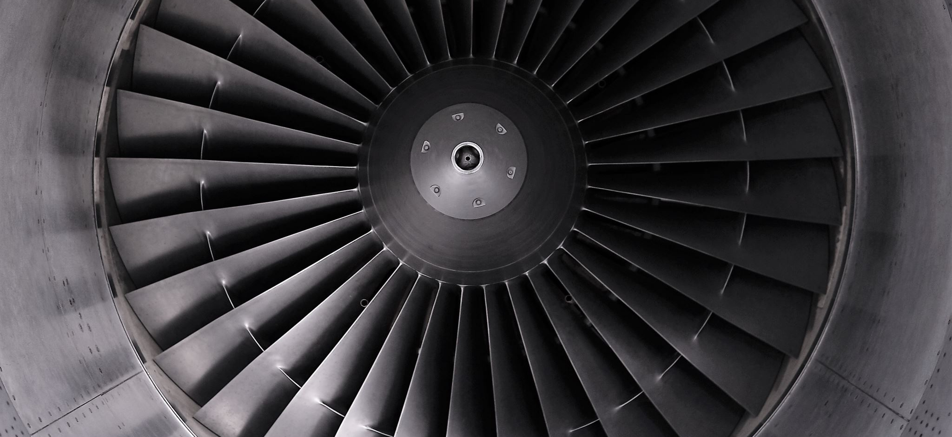
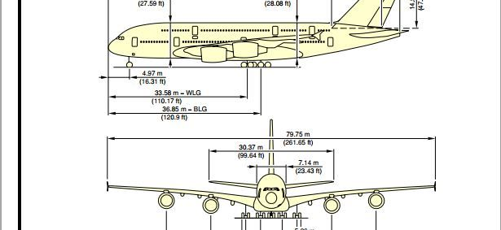
Features and Specifications
Double-deck, four-engine jet
World's largest passenger airliner until the Boeing 777X entered service in 2023.
Seating capacity of 550 passengers and a maximum capacity of 853 passengers.
Powered by four Rolls-Royce Trent 900 turbofan engines
Range of 8,000 nautical miles (14,800 kilometers).
Notes:
Sahana

Slide 16
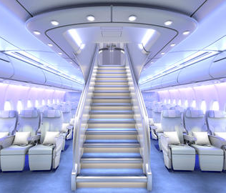
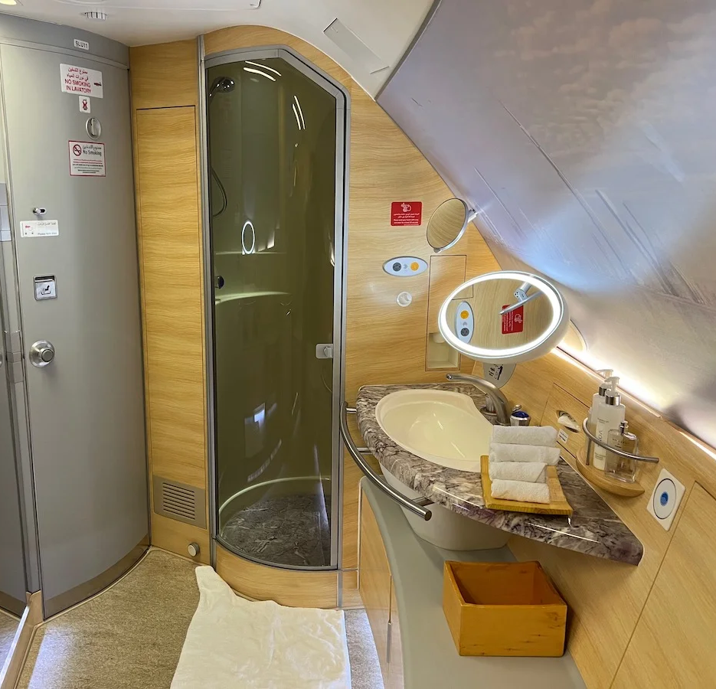

Unique features
A spacious cabin - first-class suites, business class seats, and economy class seats.
On-board bars, lounges, and showers.
Advanced noise-reduction technology.
A fuel-efficient design that allows airlines to save money on operating costs.

Slide 17
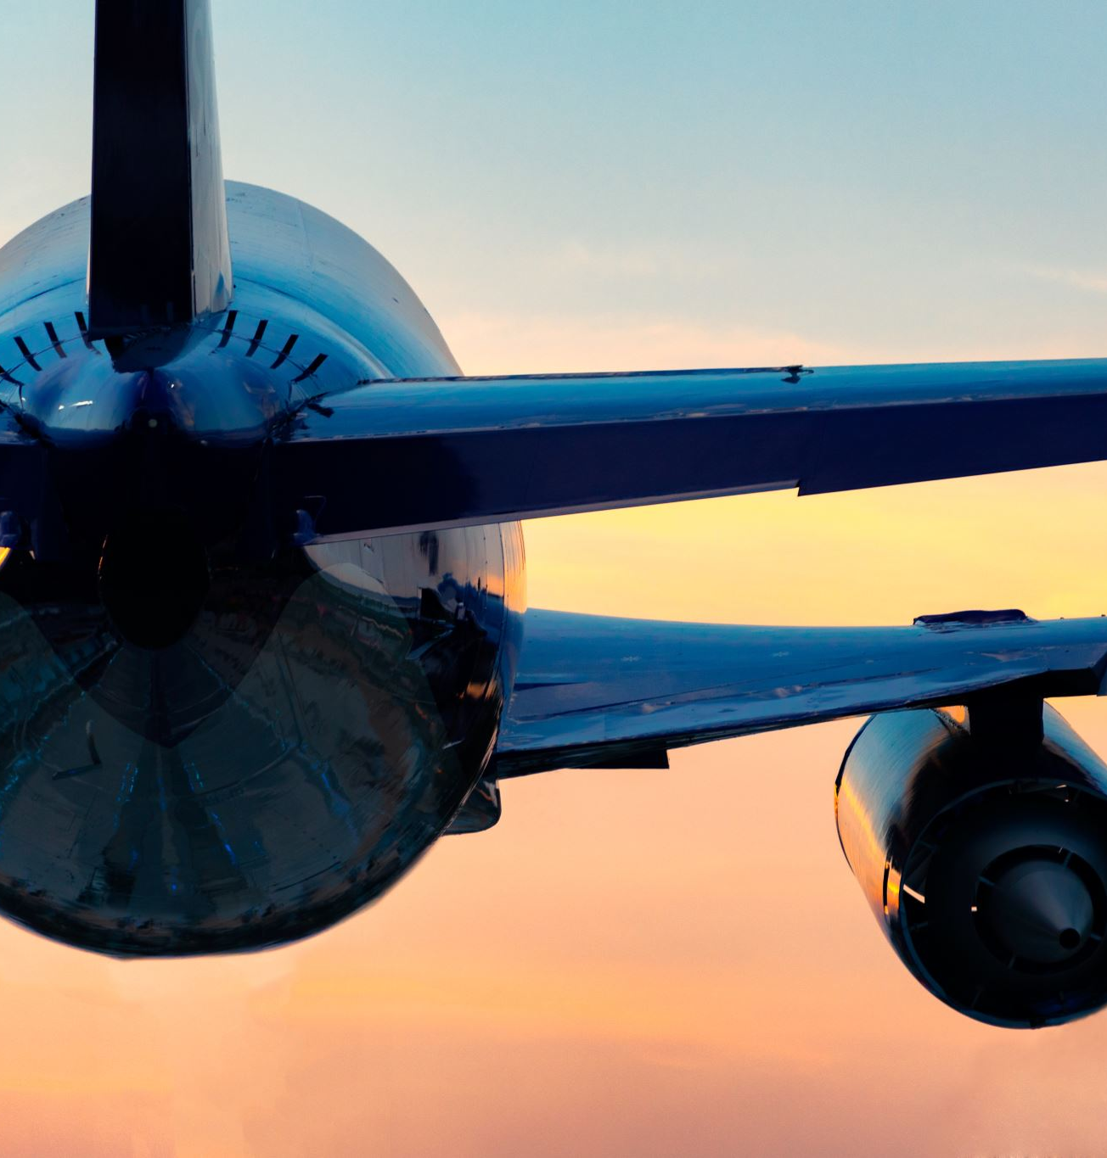
Impacts of A380:
Market Impact:
Increased Airbus's visibility in the high-capacity aircraft market
Airlines were able to offer new solutions, consolidate frequencies, and introduce new routes
Operational Benefits:
British Airways used the A380 to consolidate frequencies and release valuable slots for new destinations
Thai Airways replaced 10 weekly flights between Bangkok and Paris with a daily A380 flight to serve high-demand routes.
Network Optimization:
SIA switched all three daily Boeing 747 frequencies to A380 on its London to Singapore route, capturing high levels of demand and carrying more passengers.
Notes:
Sahana

Slide 18
Revenue Potential and Industry Recognition
Seating capacity - allowing airlines to reduce per-passenger costs and offer lower fares, attracting travelers who prefer non-stop flights.
01
Increased retail and restaurant revenue
02
Estimated operating margin - between 14% to 19%, highlighting its profitability and appeal to airlines seeking to improve their financial performance.
03
Innovative design and passenger-focused features - one of the most popular jets among passengers and industry experts.
04

Slide 19


Retail and Tourism Revenue
Increased retail and restaurant revenue
Reduced landing fees
Increased connecting traffic
Increased tourism
Example: Emirates concentrated on long-haul traffic flows between Europe, Asia, India, and Australia via its hub in Dubai, serving both primary and regional airports. Dubai’s tourism benefited from this system, and it was reported that more passengers were stopping at Dubai for tourism, conference, and business purposes. Tourism in the regions and countries linked by the Emirates has also benefited.
Notes:
Sahana

Slide 20
A380: From Ascent to Descent
In 2005, Airbus set the stage for an epic battle, launching the A380 with the audacious goal of dethroning Boeing's iconic 747.
Picture a world where aviation dreams knew no bounds, where the A380 emerged as a beacon of innovation, promising unparalleled luxury and boundless possibilities.
SO, WHAT WENT WRONG?

Slide 21


A380: Navigating Stormy Skies
In 2004, the U.S. government filed a case against Airbus at the WTO, alleging illegal subsidies amounting to $6.5 billion from the EU.
In retaliation, the EU filed a complaint against the U.S. over $19 billion in aid provided to Boeing.
Over the years, the WTO ruled that both Airbus and Boeing had received unfair subsidies, impacting market dynamics.
Significant delays in A380 production due to complex activities such as wiring installation, weight testing, and cabin interior customization.
Initial projected development cost of $10.7 billion more than doubled to over $25 billion by 2016.
Production challenges included transporting huge parts between facilities and building new infrastructure.
Allegations
Production Delays

Slide 22
Boeing's Strategic Evolution: Navigating the Aviation Landscape
Airbus A350XWB
Boeing's Dreamliner Success
Boeing 747-8 (or B747 Advanced)
Mid-2000s
2008
Boeing 787 Dreamliner
2005
Boeing's Stretched B747
2003
2000

Slide 23
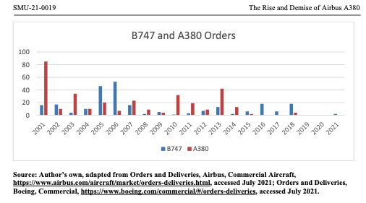
Shifting Skies: Market Dynamics
An era of transformation dawned as airlines embraced a more agile, point-to-point flight strategy, diverging from the traditional hub-and-spoke model.
As the industry adapted, the demand for colossal aircraft like the A380 dwindled, their grandeur overshadowed by the need for nimbleness and efficiency.
Shift from Hub-and-Spoke to Point-to-Point
Decreased Demand for Very Large Aircraft
Emergence of Boeing's 787 Dreamliner
Notes:
Karthik

Slide 24
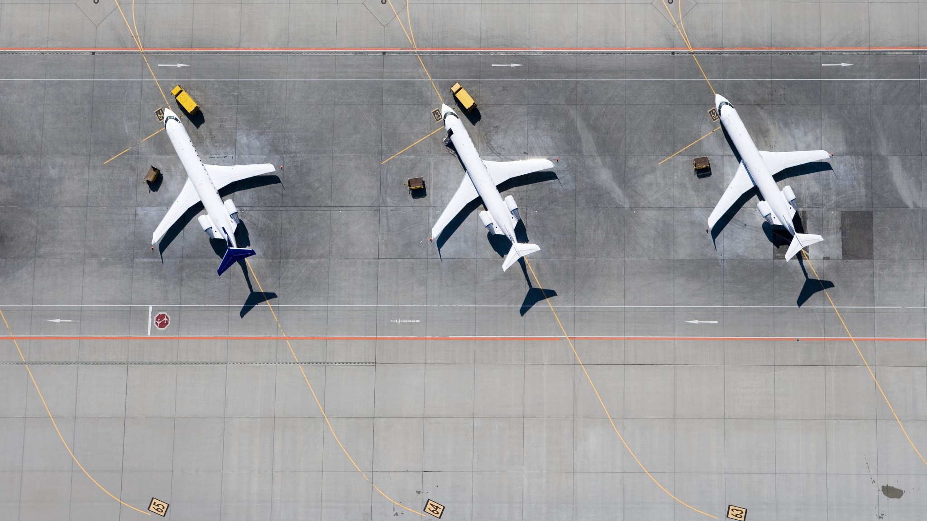
How did the 2008 recession impact the aviation strategies?
Notes:
Jayadeep

Slide 25
Fall in Demand
Declining demand for very large aircrafts by 2010
Economic downturns affecting air traffic growth.
Shift in airline strategies towards more direct flights.
Emergence of low-cost carriers favoring smaller, more fuel-efficient aircraft.

Slide 26
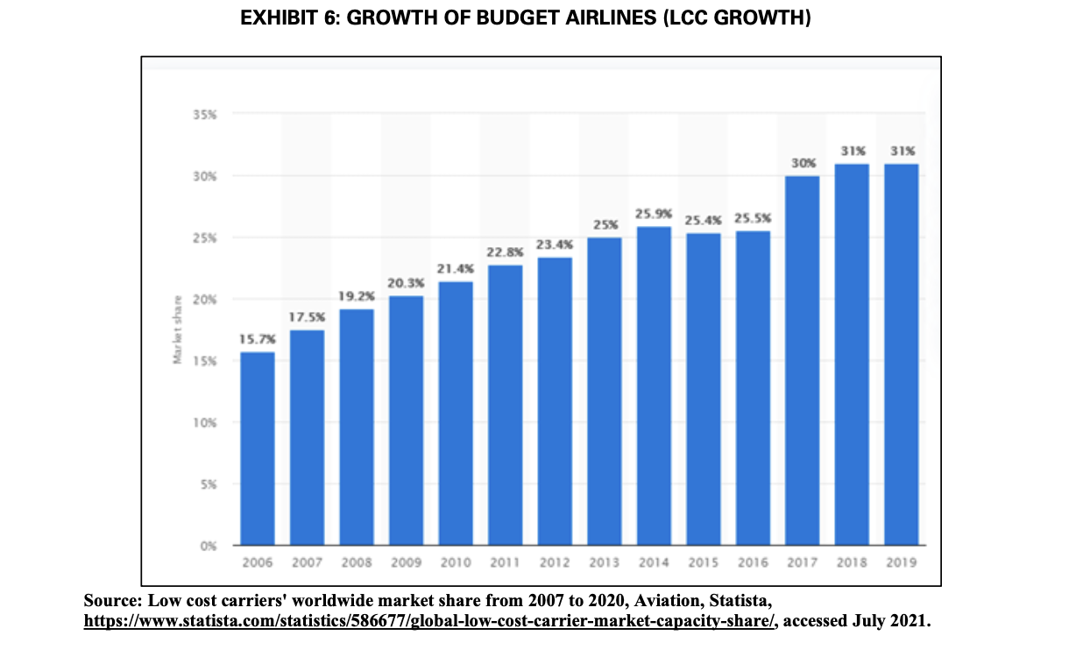
Growth of budget airlines

Slide 27
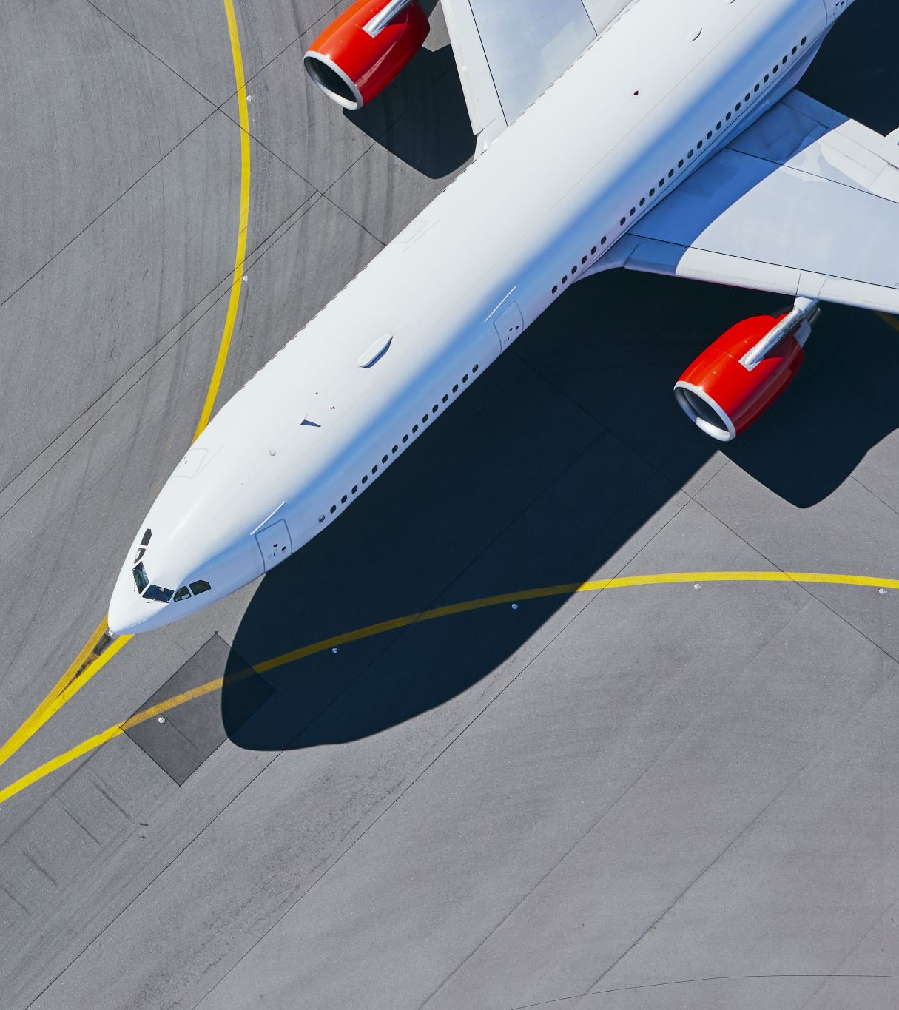
Navigating Turbulence: A380 Challenges
Limited profitability in Asia-Pacific despite dynamic growth.
Underestimation of airport infrastructure expenses.
Limited route flexibility due to size constraints.
Financial considerations
Market Impact
Notes:
Jayadeep
Financial Considerations
- High development costs and longer breakeven periods plagued large aircraft like the A380.
- Despite some sales pickups, dwindling orders and shrinking backlogs led Airbus to slash A380 production.
6. Market Impact
- Both the B747 and A380 experienced dropping demand over the years.
- Declining orders and deliveries signaled a significant downturn in demand for very large aircraft.

Slide 28
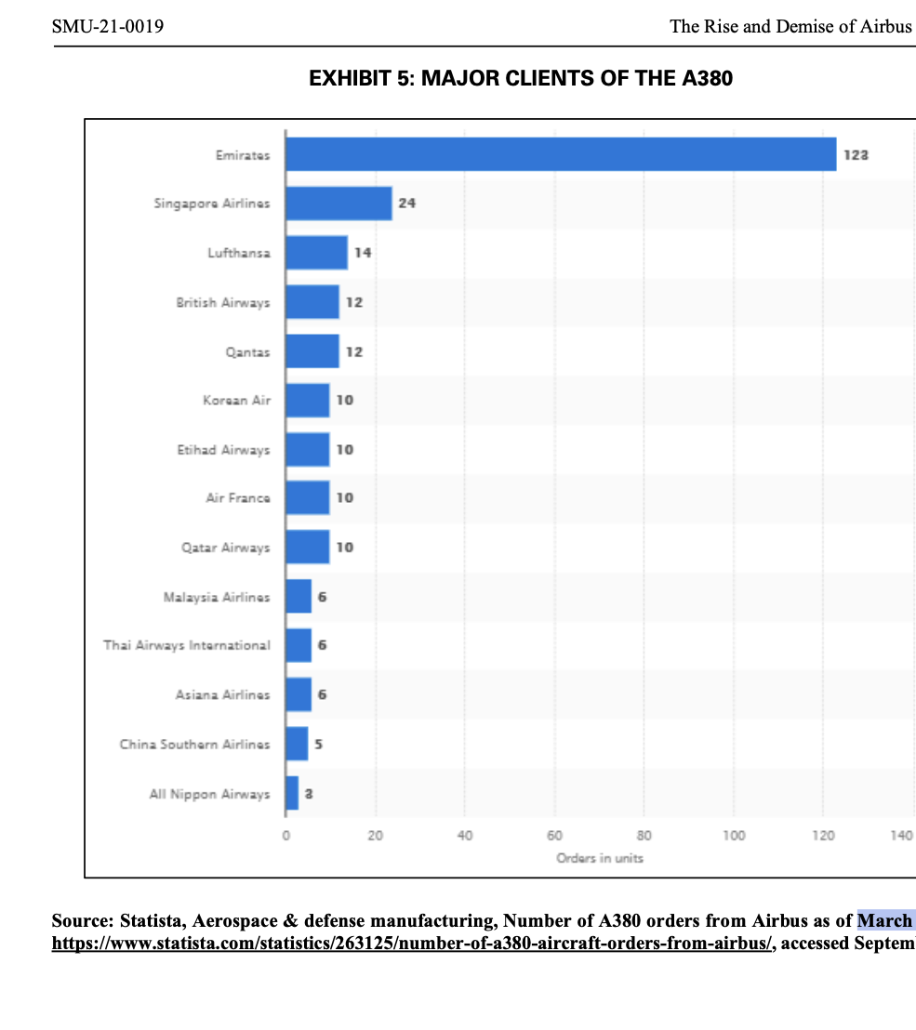
Losing Buyers
Order deferrals due to technical issues, shifting strategies
Unexpected delivery delays
Subpar economic performance
Operational Challenges

Slide 29

Market Response and Adoption
Operational challenges affected aircraft yield and efficiency.
Limited adaptation of A380 for cargo market needs.
Muted response from Chinese market due to demand and yield concerns.

Slide 30
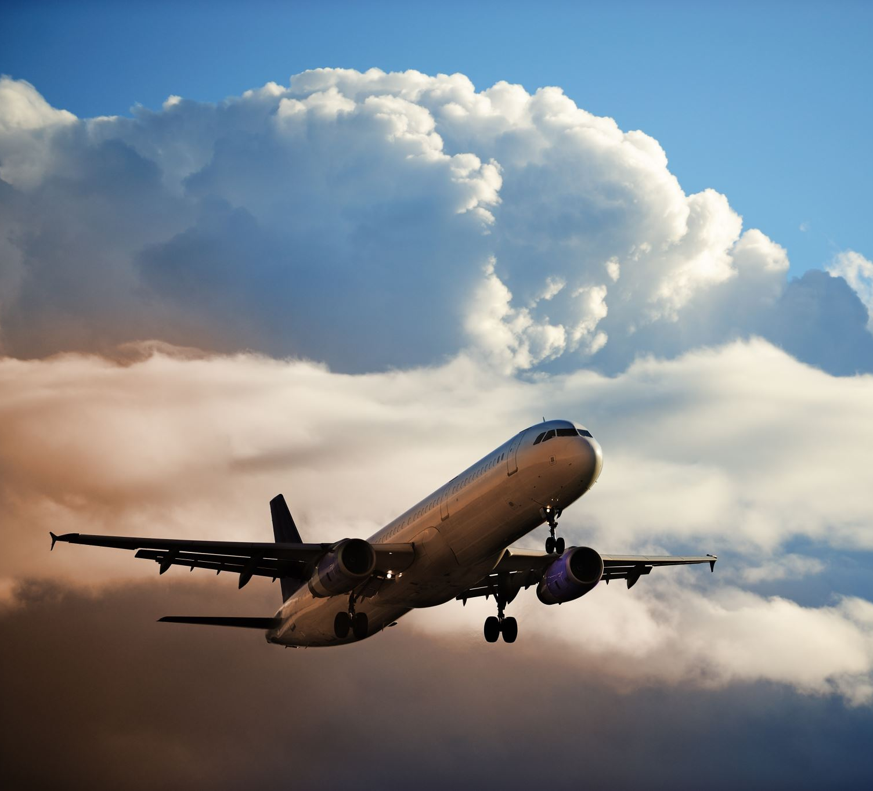
Fading Horizons: Loss of Customer Confidence
In 2014-2015, a mere 15 orders trickled in, painting a grim picture of dwindling demand and waning enthusiasm for the A380.
The year 2019 delivered a crushing blow as Emirates, a cornerstone of the A380 program, axed 39 orders, casting a shadow of uncertainty over the aircraft's future.
As market dynamics evolved, rival aircraft emerged as preferred choices, leaving the A380 behind in the race for airline patronage.
Notes:
Jayadeep

Slide 31
Narrow – bodies market trend
Growth in point-to-point routes
1
High fuel efficiency
2
Extended ranges
3
Higher maximum take-off weight
4
Rise of low-cost carriers (LCCs)
5
Willingness of passengers to accept smaller cabins
6
Projected growth in the narrow-body market
7

Slide 32
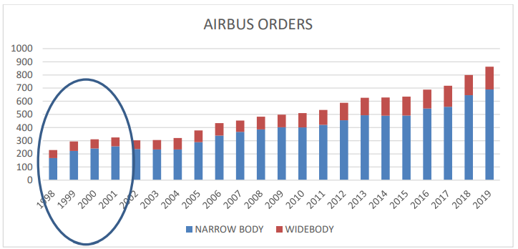
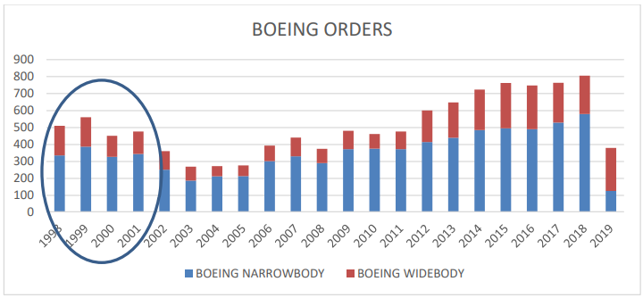
Airbus vs Boeing Deliveries (1998 – 2012)

Slide 33

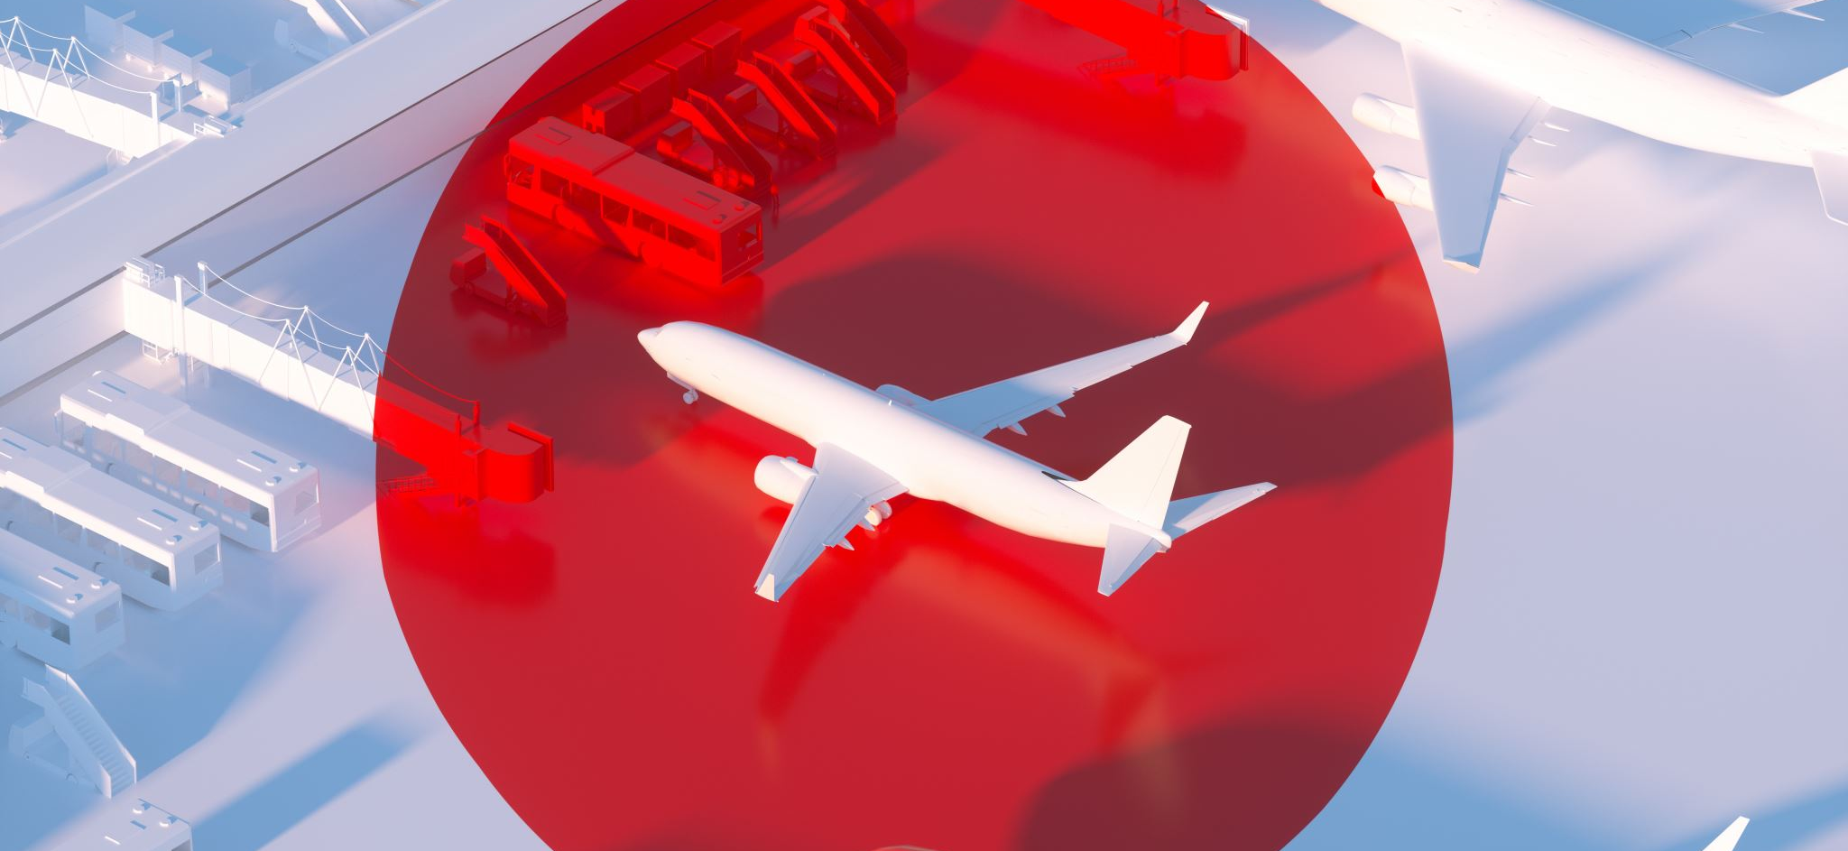
Growing China Market
China’s Aircraft Market
Future Demand
COMAC’s Role
Potential Competitor
Notes:
Nikhilan

Slide 34
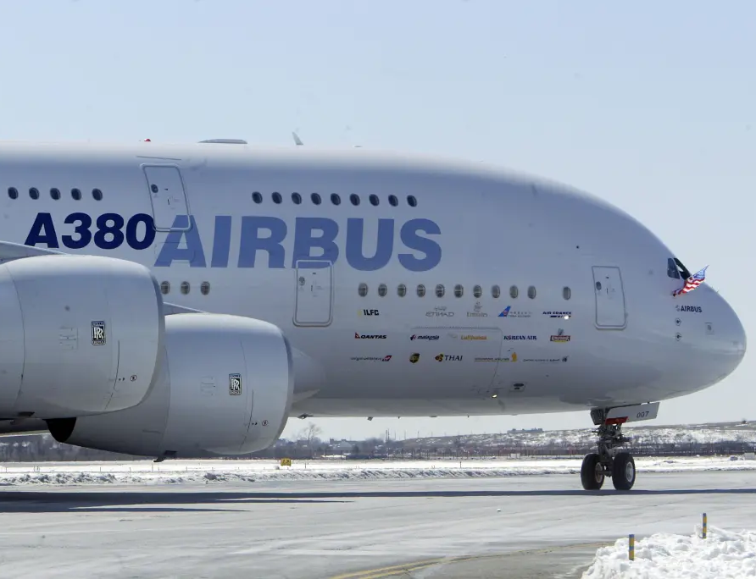
Airbus Market Lead
Airbus vs. Boeing (2019)
Boeing’s Challenges
Airbus’s Strengths
Market Position
Notes:
Nikhilan

Slide 35

Environmental Adaptations
Airbus’s Initiatives
Boeing’s Approach
“We think the laws of physics don't need to change to make hydrogen competitive on planes, it's
just a lot of work on technologies, on demonstrators, on testing, on regulations, on certification
to make it work, we believe it’s feasible within the time frame that we have developed” - Airbus CEO
Notes:
Nikhilan

Slide 36

Market Potential and organizations Strategic Considerations
Market Shifts
Competitive Response from Boeing
Timing of entry
Notes:
I'll add this to last later
Varnika
Market Potential and Strategic Considerations: The decision to launch the A380 was driven by Airbus's recognition of the potential in the very large aircraft market. They aimed to challenge Boeing's monopoly with a complete set of aircraft offerings. Despite high development costs and risks, Airbus believed in the demand for high-capacity aircraft to accommodate growing passenger numbers and alleviate airport congestion.
Market Shifts and Challenges: Despite initial success, the A380 faced challenges due to changing market conditions and trends favoring smaller aircraft and point-to-point routes over hub-and-spoke models. Increased congestion at hub airports led airlines to explore alternatives with smaller aircraft, impacting the demand for large capacity planes like the A380. Additionally, allegations of unfair subsidies and production delays contributed to the aircraft's demise.
Competitive Response from Boeing: Boeing responded to the A380 with a different strategy, focusing on smaller, more fuel-efficient aircraft like the B787 Dreamliner designed for point-to-point routes. Boeing's shift in focus and the overwhelming response to the Dreamliner forced Airbus to rethink its strategy, leading to the redesign and re-release of the A350XWB. Boeing's prediction of the growing demand for smaller aircraft and the success of its point-to-point models ultimately contributed to the decline of the A380.
Timing: Rise:
Anticipation of Market Demand: When Airbus began developing the A380 in the late 1990s, there was anticipation of significant growth in air travel demand, particularly in high-density routes between major hub airports.
Lack of Competition: At the time of its entry into service in 2007, the Airbus A380 was the only aircraft of its size and capacity in commercial operation. This lack of direct competition initially positioned the A380 as an attractive option for airlines seeking to capitalize on increasing passenger numbers and airport congestion.
Fall:
Economic Downturns: The A380's entry into service coincided with the global financial crisis of 2008, which led to reduced air travel demand and deferred orders from airlines. This economic downturn exacerbated the challenges faced by the A380 program, particularly in filling the aircraft's high capacity.
Overall, while the Airbus A380 initially rose to prominence as the world's largest passenger aircraft, its entry coincided with changing market dynamics, economic challenges, and shifts in airline preferences towards smaller, more efficient aircraft. These factors ultimately contributed to its decline and eventual discontinuation

Slide 37


Slide 38


